Slide 1
Agenda
User acquisition per platform review
Market opportunities – Channel & countries
Market opportunities – Channel
Market opportunities – Countries

Slide 2
Users acquisition per platform
% ROI on android is higher by 6%
Cost per subscribe user is higher on iOS by 21.5% VS android
Average revenue per subscription is higher on iOS by 9.9%
Suggestion: to move budgets to android
UA main KPIs per platform for Q4/16 – Q1/17
Platform | Expenses | Subscriptions | Cost per subscription | Total Revenue | Avg. Revenue for subscription | % ROI
ios | $862,532 | 19,123 | $45.1 | $469,732 | $24.6 | 54%
android | $390,596 | 10,518 | $37.1 | $235,126 | $22.4 | 60%

Slide 3
Users acquisition per platform
% Conversion of subscribed user is higher on iOS by 3.7%
The median Revenue from subscribe user is ~even among platforms
However, the average is higher on iOS by 7.7% ($86.6 VS $80.4)
% conversion (from subscribed users)
Revenue ($) from subscribe users per percentiles per platform

Slide 4
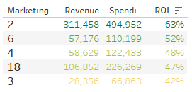
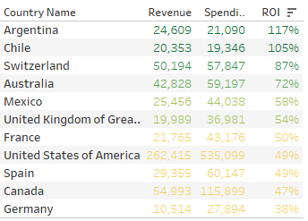
Market opportunities – ROI per country &channel
Overall ROI
The higher % ROI in Latin America
The higher % ROI in marketing channel 2
% RO per Marketing channel
% RO per country

Slide 5
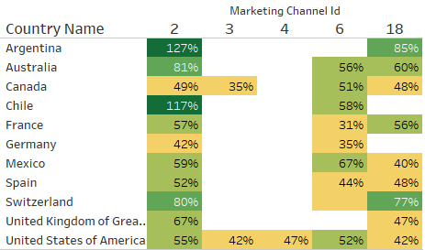
Market opportunities – ROI per country &channel
Suggestion: invest the marketing channel per region
For example: in Latin America channel 2 has the best ROI
% RO per country per channel
% RO per country

Slide 6
Market opportunities – Channels
Channel 4 has the best % conversion for subscribe users, and very high average revenue from paying users ($217), however it has the highest cost per subscribe user → Therefore it has ~ average ROI, looking on the whole 4 months together
On Oct’16 and Nov’16 Channel 4 has the highest ROI, need to check the reasons for the drop on Dec’16 and Jan’17 (while the rest of the channels are stable)
On Jan’17 the spending on the app grew 3 times over Dec’16, and the revenue effect might come in delay, especially in Channel 4 (high avg. revenue from paying users → high potential)
So on Feb we might see more clear results and get decisions about Channel 4
KPIs per channel
Cumulative % ROI per channel
Marketing Channel Id | % conversion | cost per subscribe users ($) | Avg. revenue from paying user ($) | % ROI
2 | 72% | 133 | 117 | 48%
3 | 56% | 131 | 99 | 42%
4 | 85% | 386 | 217 | 48%
6 | 72% | 123 | 88 | 42%
18 | 54% | 81 | 71 | 47%
Marketing Channel Id | Oct’16 | Nov’16 | Dec’16 | Jan’17
2 | 64% | 67% | 67% | 63%
3 | 54% | 46% | 48% | 42%
4 | 97% | 77% | 55% | 48%
6 | 56% | 56% | 53% | 52%
18 | 47% | 51% | 49% | 47%

Slide 7
Market opportunities – Countries
United kingdom has average ROI , and stable during the last few months
Relatedly low cost per subscribe user, and low avg. revenue from subscribe paying user
I suggest not to increase the investment, as it seems we have better opportunities
KPIs per channel
Cumulative % ROI per country
Country Name | % conversion | cost per subscribe users ($) | Avg. revenue from paying user ($) | % ROI
Argentina | 58% | 35 | 71 | 118%
Australia | 65% | 67 | 74 | 74%
Canada | 60% | 94 | 75 | 47%
Chile | 63% | 57 | 94 | 139%
France | 56% | 80 | 72 | 52%
Germany | 48% | 65 | 51 | 38%
Mexico | 47% | 58 | 71 | 60%
Spain | 62% | 164 | 130 | 50%
Switzerland | 74% | 82 | 96 | 85%
United Kingdom | 56% | 55 | 52 | 55%
United States | 81% | 274 | 165 | 49%
Country | Oct’16 | Nov’16 | Dec’16 | Jan’17
Argentina | 85% | 83% | 100% | 117%
Australia | 73% | 80% | 80% | 72%
Canada | 46% | 48% | 46% | 47%
Chile | 83% | 130% | 112% | 105%
France | 50% | 51% | 50% | 50%
Germany | 40% | 44% | 43% | 38%
Mexico | 65% | 62% | 54% | 58%
Switzerland | 92% | 86% | 83% | 87%
United Kingdom | 60% | 57% | 52% | 54%
United States | 57% | 59% | 55% | 49%

